Slide 1
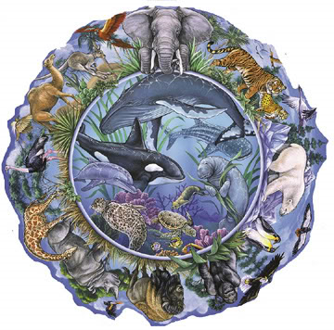
Widening the Circle
Thinking about both genders other cultures, other species, and other generations

Slide 3
‘Economics for people and the planet’
Many perspectives are never considered by a system of economics that privileges white, wealthy, western men
An extention of a colonial system whereby the resources and people of most of the planet are harnessed to improve the living standards of the minority of people who live in the privileged West.
Maria Mies has extended the notion of colonialism to include all those whose labour is exploited, including homeworkers, peasants, women, and the planet itself

Slide 4
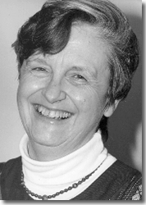
Half the sky – the largest ‘minority’
‘it is inherent in the methodology of economics to ignore man’s dependence on the natural world’. E. F. Schumacher
Women form 70 per cent of the world’s poor and own only 1% of the world’s assets (Amnesty International).
Women earn only 50% of what mean earn UNFPA (2005)

Slide 5
Mary Mellor, ‘Challenging Economic Boundaries: Ecofeminist Political Economy’, 2006.
Economic man is fit, mobile, able-bodied, unencumbered by domestic or other responsibilities. The goods he consumes appear to him as finished products or services and disappear from his view on disposal or dismissal. He has no responsibility for the life-cycle of those goods or services any more than he questions the source of the air he breathes or the disposal of his excreta . . . Like Oscar Wilde’s Dorian Gray, economic man appears to exist in a smoothly functioning world, while the portrait in the attic represents his real social, biological and ecological condition.

Slide 6
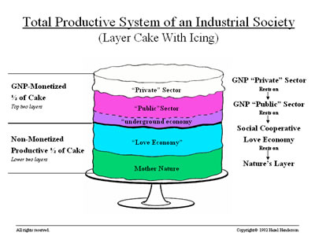
The icing on the cake?

Slide 7
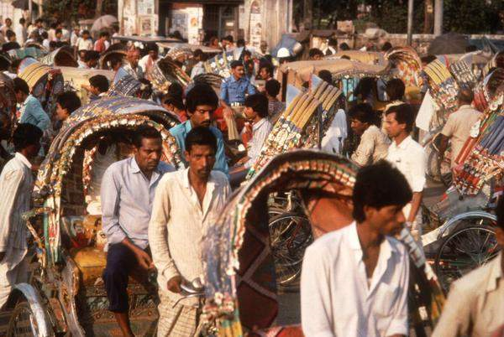
The majority world

Slide 8
Who is causing the crisis
 | USA | Europe | Asia | Africa | World
Energy | 8520 | 3546 | 892 | 580 | 1640
CO₂ emissions | 20.3 | 8–12 | <1 | <1 | 3.85
Daily water | 430 | 159 | 172 | 47 | 173

Slide 9
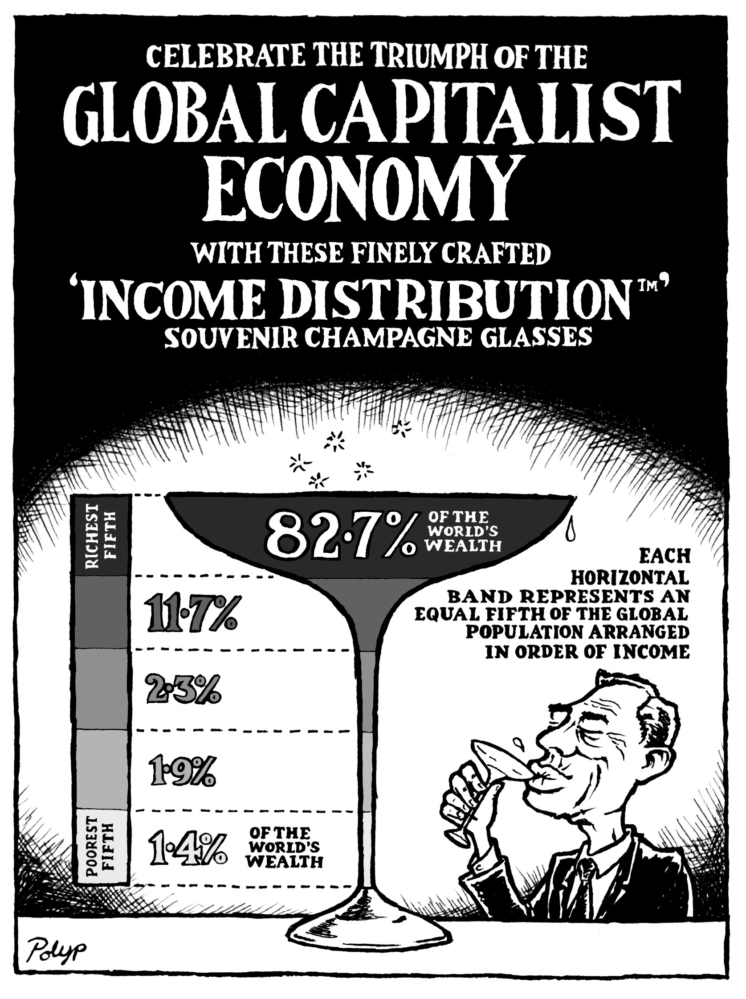

Slide 10
Indigenous perspective
All land is sacred. It is their bible. Indigenous people do not see the land as a commodity which can be sold or bought. The do not see themselves as possessors but as guardians of the land. A fundamental difference between the indigenous concept of land and the western idea is that indigenous peoples belong to the land rather than the land belonging to them.
Zapata and Schielman, 1999: 236

Slide 11
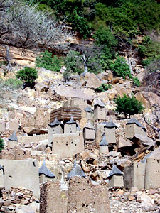
Learning from the South
‘the land and its bounty plays an important part in the religious views of the Dogon. The Lebe cult is primarily concerned with agricultural renewal, and altars devoted to it have bits of earth incorporated into them to encourage the continued fertility of the land.’

Slide 12
Learning from the Ancestors
‘That we may work in righteousness, and lay the Foundation of Making the Earth a Common Treasury for All, both Rich and Poor, That every one that is born in the Land, may be fed by the Earth his Mother that brought him forth, according to the Reason that rules in the Creation.’
Gerard Winstanley, St. George’s Hill, London, April Fool’s Day 1649

Slide 13
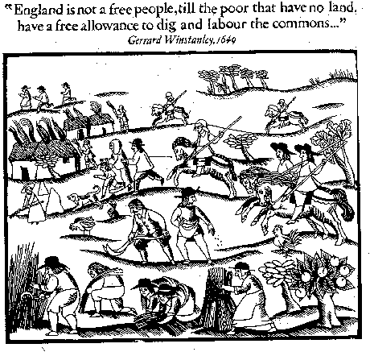
Guerrilla gardening?
Time of religious and political turmoil
England’s Civil War or England’s Revolution?
Questions of land ownership we will come back to?
Who cares for land better?

Slide 14
Other species
‘people are not orthodox individualists. . . they feel that they live within a vast whole—nature—which is in some sense the source of all value, and whose workings are quite generally entitled to respect. They do not see this whole as an extra item, or a set of items which they must appraise and evaluate one by one to make sure whether they need them. They see it as the original context which gives sense to their lives . . . From this angle, the burden of proof is not on someone who wants to preserve mahogany trees from extinction. It is on the person who proposes to destroy them.’
Midgley, 1996

Slide 15
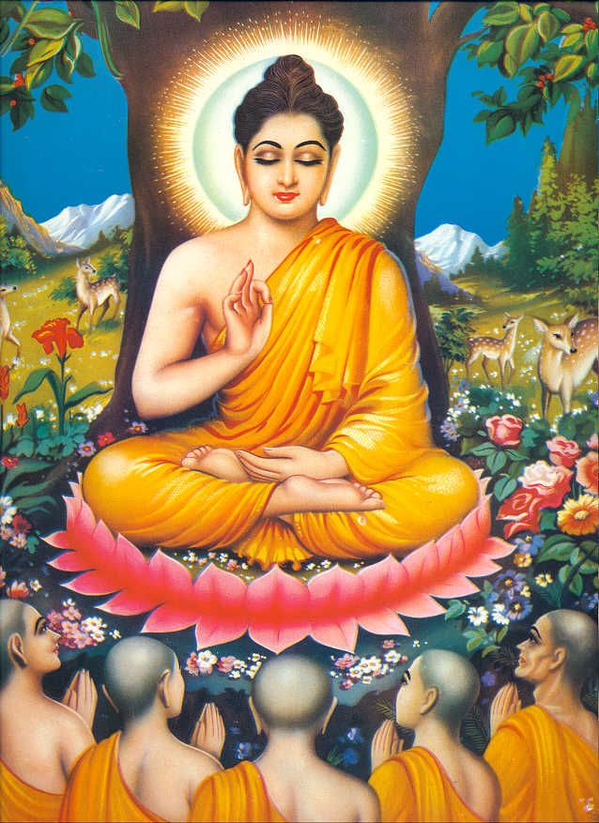
Buddhist economics
‘May All Beings Be Well and Happy’
‘Right Livelihood’ should not sacrifice the well-being of other species
Shamanistic need to ask permission to consume other creatures

Slide 16
Future generations
Importance of intergenerational equity inherent in the Brundtland declaration that is the basis of ‘sustainable development’:
Meeting the needs of current generations without compromising the ability of future generations to meet their own needs

Slide 17
Discounting the future
Consequences of many environmental losses and impacts will be felt many years into the future
Climate change—2050 to 2100
Nuclear pollution—hundred of thousands of years
How to set prices into the future?
Neoclassical economists use a method known as ‘discounting’.

Slide 18
Techniques of discounting
This translates the environmental impact from the future into a present value which is expressed as:
PV(B) = B_{T}/(1-r)^{T}
where r is the discount rate, B is the benefit or cost (C) accruing in T years’ time.
Such a formula has the effect of diminishing the impact of environmental destruction caused in this present time-period and making our current actions appear less costly to future generations.

Slide 19
Consequences for future generations?
‘Pure time preference’ and ‘wealth’ components
The higher the discount rate, the lower the future costs of current actions
‘Descriptive’ discounting assumes that the discount rate should just be equivalent to the prevailing interest rate
Interest rates of 5-10% massively diminish the present value of the distant future

Slide 20
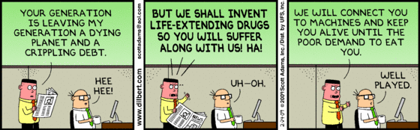
What is in it for ‘us’; who are ‘we’?

