Slide 1
Environment and Economy
Is the tension inevitable?

Slide 2
What do we mean by the ‘environment’?
The source of all the resources that are used in the production of goods that are sold in the marketplace or that we use to support our lifestyles
Is it distinct from ‘land’?
How do we feel about the ‘exploitation’ of resources?

Slide 3
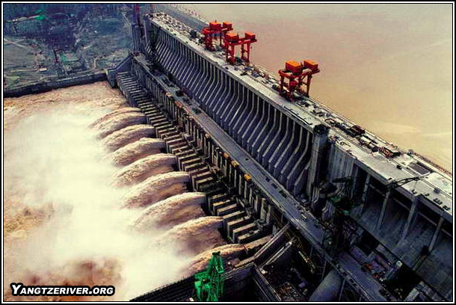
Environmental stresses interrelate
China builds new power stations to facilitate production
To offset CO2 China builds vasts hydroelectric dams (using energy and producing CO₂ via the production of concrete)
Hundreds of thousands of subsistence farmers are drawn into an economic system that itself relies on fossil fuels where their previous existence did not.
Dam projects disturb the local ecosystem, causing species loss and loss of topsoil

Slide 4
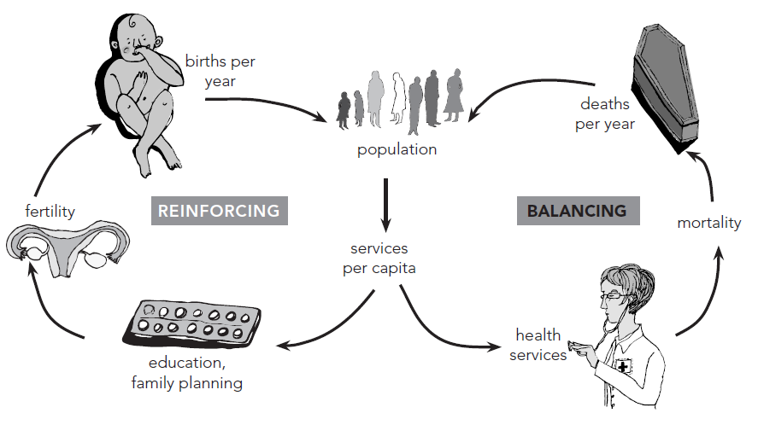
Thinking in systems

Slide 5
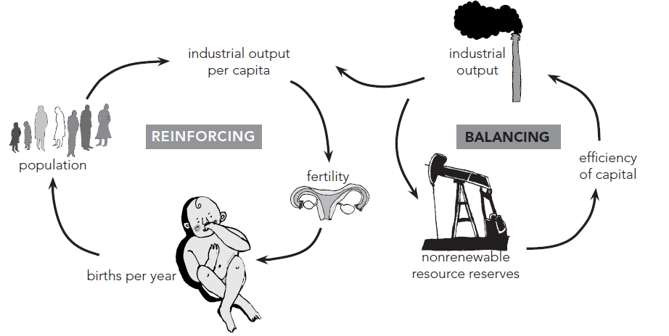

Slide 6
Rethinking economics concepts
Efficiency: energy or financial efficiency?
Optimality: who do we consider in the allocation?
Sustainability
  Brundtland definition?
  Strong sustainability (no substitution for natural capital) vs. weak sustainability (substitution is possible)

Slide 7
Defining the schools
Neoclassical economics: no particular need to address the environment as a special issue, since the market will naturally resolve all problems, including environmental problems
Environmental economists: environment as a source of special concern in their work, but use the methods and tools of neoclassical economics
Ecological economists: attempt to unite the understandings of ecology and of economics
Green and ecosocialist: the problem is structural and related to the way capitalism functions as a system

Slide 8
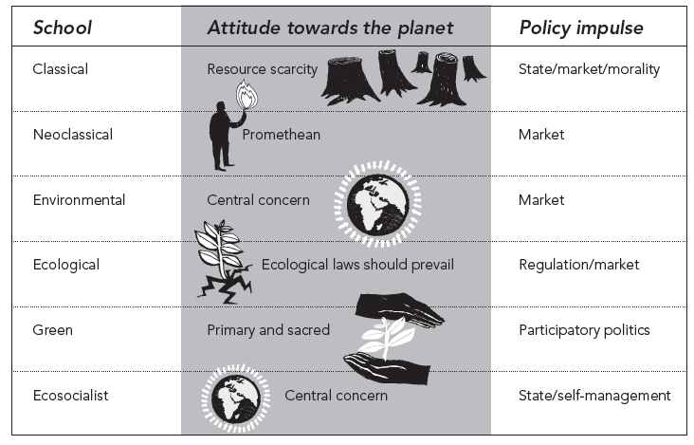

Slide 9
Environmental economics aims to achieve sustainability by the indirect means of financial instruments such as taxes and subsidies. Ecological economics, by contrast, places economics within the systemic context of ecology. It therefore questions the possibility of ensuring sustainability solely by means of internalizing environmental costs into the market mechanism. . . . Of course this ‘ecological’ approach can be combined with the policy instruments of environmental economics . . . Authors in the green paradigm tend to take this pragmatic approach to the question of the suitability of different forms of intervention in the market. (Greenwood, 2007: 78).

Slide 10
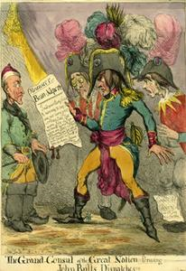
Way back when . . .
‘The physiocrats of mid-eighteenth-century France—the first economic theorists—tried to explain economics in accordance with natural law and saw agriculture and Mother Earth as the source of all net value.’ (Daly and Townsend, 1993: 13).
Minimal political interference

Slide 11
Physiocrats vs. Mercantilists
The mercantilists argued for a market regulated so as to ensure the most efficient and rapid production of manufactured goods, which could then be traded
They began to equate wealth with money, as opposed to the physiocratic view that all wealth came from the land
The state should accumulate reserves of precious metals
The role of the state was to protect domestic production and trade through the use of tariffs and subsidies.

Slide 12
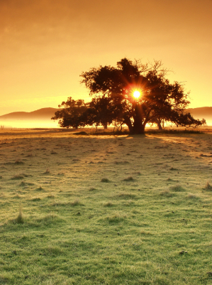
The ‘marginalisation’ of land
At this stage ‘the land’, which we might see as at least partly analogous to ‘the environment’ slips from the central place in thinking about the economy that it had always held
This loss of focus on the environment as the true source of wealth may help to explain the uncomfortable relationship that has developed between the economy and the environment.

Slide 13
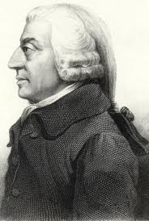
Classical political economy
Adam Smith, David Ricardo and John Stuart Mill
Foregrounded the role of labour
Adam Smith: pin-making and the division of labour
Skill, innovation and productivity are the sources of wealth

Slide 14
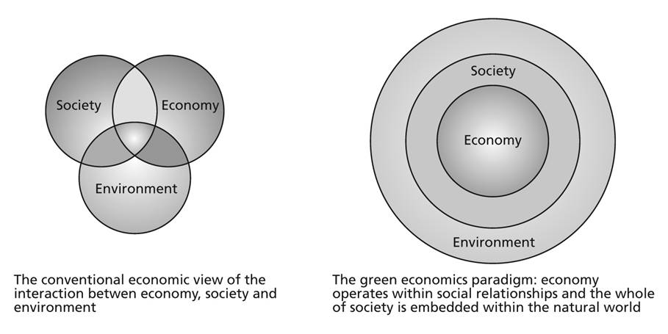
Where is the environment?

Slide 15
Placing the Schools
‘Sustainable development’: three circles as interrelated, but separate, so that there are some parts of the economy that have nothing to do with society or the environment. Neoclassical economists focus predominantly on the right-hand circle
Environmental economists put more emphasis on the environmental circle
Ecological economists: focus on the left-hand circle
Green economists see the three circles as interrelated (as on the right)
Anti-capitalist economists focus on the upper and left-hand circles

