Slide 1
The Place of the Environment in Neoclassical Economics

Slide 2
Central tenets of the neoclassical position
Neoclassical theory as neutral and value free: like Newton’s laws of physical motion it aims to define a set of laws governing economic activity.
Forces of supply and demand interact to achieve optimal outcomes for all
Economic decisions are made on the basis of ‘utility maximization’
The economy is a dynamic system with a multitude of individual players, none the less it reaches an equilibrium where these forces are in balance.

Slide 3

What do we mean by equilibrium?
The objective is to reach ‘equilibrium’ but this is not a static point
Neoclassical economics sees growth as a/the key goal
A ‘Promethean’ view of the availability of resources and human ingenuity
19th-century mastery over nature

Slide 4
What is an efficient allocation?
Market system is superior because it allocates goods and services efficiently
Vilfredo Pareto: an allocation is ‘efficient’ if there is no way that a person who is receiving some of that resource could receive more without some of that resource being taken away from somebody else
Does not concern itself with relative shares
Does this also work with environmental ‘goods and services’?

Slide 5
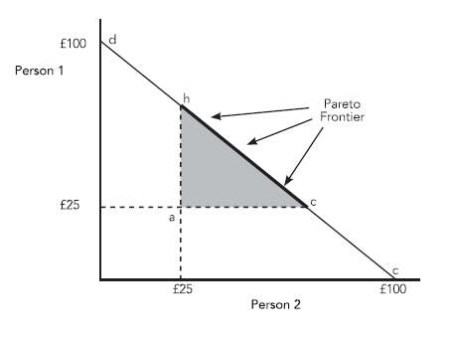
Notes:
The figure illustrates the ‘efficiency frontier’ for the allocation of a good between two people; when the goods are allocated efficiently the total value allocated is £100. At point d person 1 received all of the good; at point 3 person 2 receives all of the good. At points in between, and along the frontier, allocations are more or less equal but all are efficient. Anywhere within the frontier, say point a, where each person receives an amount of the good worth £25, the allocation is inefficient, since by moving to the frontier, either one person or the other could receive more of the good. From point a, a move could be made to either point b or point c, allowing an increase in utility represented by the shaded triangle. It is notable that this allocation model does not concern itself with the relative shares acquired by the two people.

Slide 6
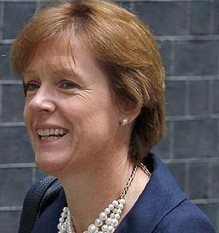
What is the role of government?
Neoclassical theorists favour the cost-benefit analysis
It measure the Pareto optimality of a particular policy, like a new road
Sum all the costs and benefits of a project: so long as the benefits outweigh the costs then the decision should be made for the project to go ahead.

Slide 7
How does cost-benefit analysis work?
The CBA begins by defining clearly what is being measured: what time-period is being considered, exactly what changes will be made, whose welfare is being included in the equation. The next stage is to identify all the physical impacts of the project before the most difficult stage of all: costing the impacts. All the calculations are worked in monetary values, which means that a monetary cost must be calculated for any positive of negative impact of the proposed action. In addition, a discount rate is applied, to allow for the fact that costs and benefits may not have equal real value at different periods in time. This technique, which can have a huge impact on the likelihood of a policy being introduced, is discussed in the next section.

