Slide 1
Environment and Economy
Some of those who first blew the whistle

Slide 2
Environmental Crisis?
Problem | Agent
Climate change | Greenhouse gases
Ozone depletion | Emissions of CFCs
Species extinction | Loss of habitat
Fishery destruction | Over-fishing
Deforestation | Unsustainable agriculture
Land degradation | Over-exploitation; cash crops
Depletion of natural resources | Over-exploitation

Slide 3
It’s the Economy, Stupid!
Problem | Agent
Climate change | Industrial production
Ozone depletion | Production of refrigerants
Species extinction | Production of cash crops
Fishery destruction | Over-fishing
Deforestation | Production of cash crops
Land degradation | Biofuels; over-production
Depletion of natural resources | Production for consumptive society

Slide 4
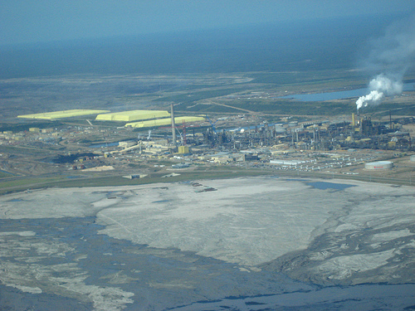

Slide 5
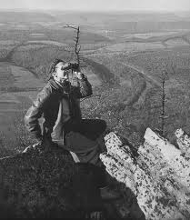
Rachel Carson
US marine biologist: 1907-64
Linked the environmental crisis she witnessed to synthetic pesticides (especially DDT) and radionuclides

Slide 6
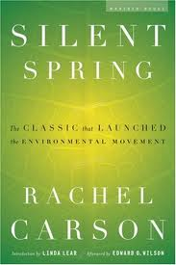
Key work
Silent Spring (1962)
Argued that DDT was destroying the natural world—in this case making birds’ egg shells porous so that birds could not breed.
Carson herself died from breast cancer

Slide 7
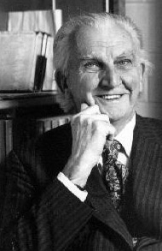
Kenneth Boulding
Taught at Michigan and Boulder universities
His later work, an attempt at cross-fertilisation between biology and economics, can be seen as a precursor to the development of ecological economics

Slide 8
Key ideas
Boulding considered that the discipline of economics chose its subject-matter too narrowly and was ignoring the important environmental impacts of the economic system.
Boulding was an early proponent of the call to move towards a non-growth or ‘steady state’ economy, and is famous for his statement that:
‘Anyone who believes that exponential growth can go on forever in a finite world is either a madman or an economist’.

Slide 9
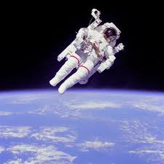
Key work
Boulding, K. E. (1966), ‘The Economics of the Coming Spaceship Earth’, in H. Jarrett (ed.), Environmental Quality in a Growing Economy (Washington, DC: Johns Hopkins University Press); available online at: http://www.panarchy.org/boulding/spaceship.1966.html

Slide 10
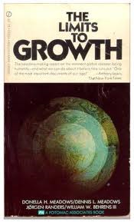
The Club of Rome
A group of businessmen, academics and others who questioned the environmental impact of exponential growth
Limits to Growth was published in 1972 and was very influential

Slide 11
Key idea: Exponential growth
A French riddle for children illustrates another aspect of exponential growth—the apparent suddenness with which it approaches a fixed limit. Suppose you own a pond on which a water lily is growing. The lily plant doubles in size each day. If the lily were allowed to grow unchecked, it would completely cover the pond in 30 day, choking off the other forms of life in the water. For a long time the lily plant seems small, and so you decide not to worry about cutting it back until it covers half the pond. On what day will that be? On the twenty-ninth day, of course. You have one day to save your pond. (Meadows, et al., 1972: 29).

Slide 12
UK Economic Growth measured as GDP, not adjusted for inflation (£m.): Data from UK Treasury

Slide 13
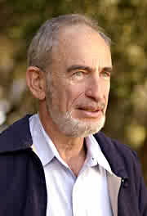
Paul Ehrlich
‘The battle to feed all of humanity is over. In the 1970s and 1980s hundreds of millions of people will starve to death in spite of any crash programs embarked upon now. At this late date nothing can prevent a substantial increase in the world death rate.’

Slide 14
Key idea: IPAT Equation
Environmental impact of economic activity is a combination of population size, consumption level, and the efficiency of technological processes. A simple mathematical equation including these three variables generates IPAT: I = P × A × T
Impact = Population × Affluence × Technology
Compare environmental impact of car ownership in Brazil, China and the USA
Country | Population (000s) | Car ownership | IPATª
China | 1303720 | 32 | 41.71904
USA | 295896 | 820 | 242.63472
Brazil | 186831 | 198 | 36.992538

Slide 15

Key work
The Population Bomb (1968)
[from ‘What the Liberals Say’]
“The Population of the U.S. will shrink from 250 million to about 22.5 million before 1999 because of famine and global warming.”
Source: The Professors -- The 101 Most Dangerous Academics in America, by David Horowitz, 2006, page 140.

Slide 16
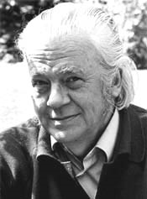
E. F. Schumacher
1911-1977, born in Germany
Brilliant conventional economist who became concerned about resource use when he worked for the National Coal Board
Coined the phrase ‘small is beautiful’

Slide 17
Key ideas:
Intermediate technology: sceptical about technology: ‘technology with a human face’
Schumacher was concerned with the ever-increasing scale of production systems: he believed that development should take place outside the cities and create an ‘agro-industrial structure’ of small towns based in the countryside
Buddhist economics—the quality of work and production was as important as the quantity. Use the buddhist concept of ‘right livelihood’

Slide 18

Key work
…the reign of quantity celebrates its greatest triumphs in "the Market." Everything is equated with everything else. To equate things means to give them a price and thus to make them exchangeable. To the extent that economic thinking is based on the market, it takes the sacredness out of life, because there can be nothing sacred in something that has a price.

Slide 19
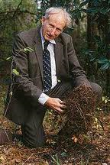
Howard Odum
1924-2002
Interdisiplinary work: environmental sciences, ecological modelling, meterology, zoology, systems ecology and ecological economics

Slide 20
Key ideas:
Ecosystem ecology
Entropy: quantity of energy matters too
Emergy: energy beings with the sun and is transformed by natural and technological processes. Odum proposed that a measurement of the amount of transformed solar energy embodied in any product of the biosphere or human society—for which he coined the term ‘emergy’—could provide a kind of ‘universal currency’ which would allow fair and accurate comparison of the human and natural contributions to any particular economic process.

Slide 21
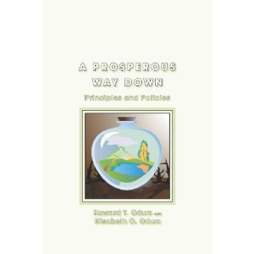
Key work
A Prosperous Way Down
Proposed the need for an energy descent
Influential on the permculature movement

Slide 22

Hazel Henderson
1933-present
Born in Bristol but worked mainly in the US

Slide 23
Key ideas:
Markets as social: Critical of the ‘free market system’ (the quotation marks are hers)
A sustainable economy as one where the power is stripped away from global corporations and reinstated again in enterprises owned and controlled by their own workers based in strong, mutually oriented communities
An economy focused on provisioning based on a culture of relationship rather than on markets mediated through money
Critical of the economics profession and its narrow, neoclassical approach: ‘Three hundred years of snake oil: defrocking the economics priesthood’

Slide 24
Key work
The Politics of the Solar Age
Includes the ‘icing cake’ model of the global economy

Slide 25

Total Productive System of an Industrial Society
(Layer Cake With Icing)
GNP-Monetized
½ of Cake
Top two layers
Non-Monetized
Productive ½ of Cake
Lower two layers
GNP “Private” Sector
Rests on
GNP “Public” Sector
Rests on
Social Cooperative
Love Economy
Rests on
Nature’s Layer
“Private” Sector
“Public”Sector
“underground economy
“Love Economy”
Mother Nature
All rights reserved. Copyright© 1982 Hazel Henderson

